Slide 1



Revit API Events, the Forgotten Power
09-10-2019
Dan Tartaglia / BIM Platform Leader

Slide 2


London
Seattle
Columbus
Boston
San Francisco
New York
Shanghai
Los Angeles
Hong Kong

Slide 3
Presentation Description
This is a very powerful ability in custom Add-Ins you have had access to in the Revit API for years but how many companies take advantage of their power? In this presentation we will look at a number of examples and show the huge value these events have.
Learning Objectives
At the end of this presentation, participants will be able to:
1. Learn what the Revit API is and what Revit API Events are
2. Learn where you can find resources and support to create Revit Add-Ins
3. Demonstrate example Add-Ins using Revit API Events and discuss their value
4. Step through the some code to understand how Revit API Events work in real-time

Slide 4

Quick Survey:

Slide 5
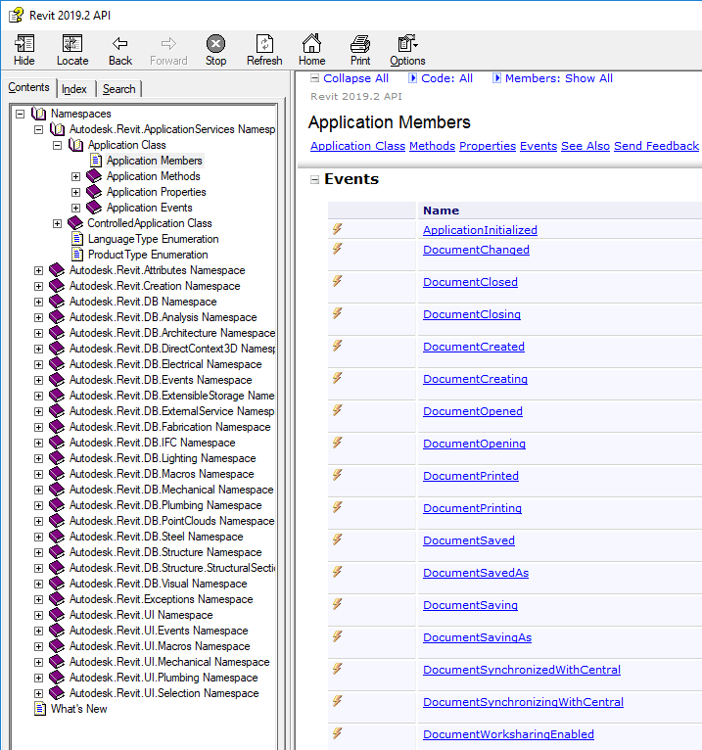




What is the Revit API?
Add-In
Dynamo
Install the Software Developer Kit (SDK) to get the Samples, RevitAPI.chm and more
http://www.revitapidocs.com/

Slide 6
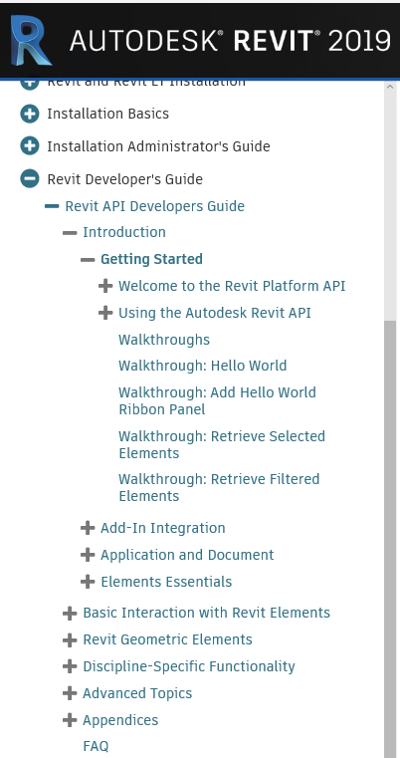
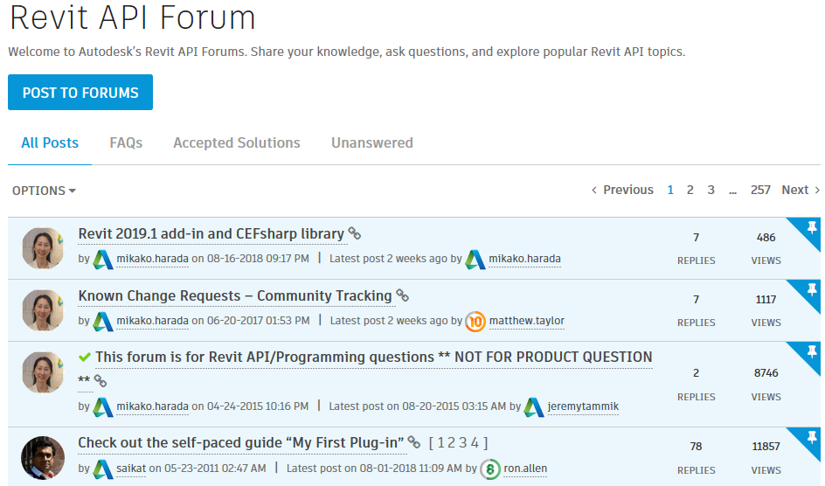
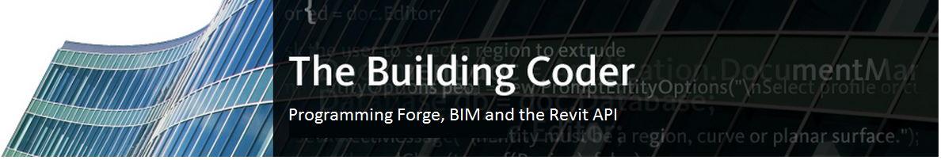
Learning and support for Revit Add-Ins:
Revit on-line help file
http://help.autodesk.com/view/RVT/2019/ENU/
Revit API Autodesk Community
https://forums.autodesk.com/t5/revit-api-forum/bd-p/160
The Building Coder
http://thebuildingcoder.typepad.com/

Slide 7
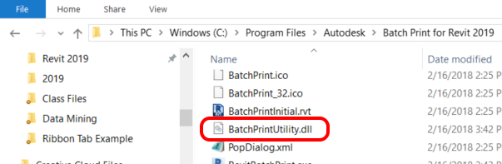
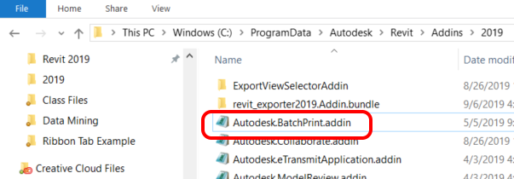
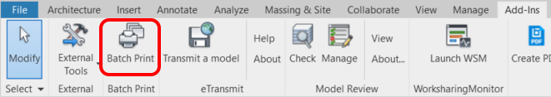
How an Add-In Works:

Slide 8

What are Revit API Events?
Hook Functions
DocumentOpening()
DocumentClosing()
ViewPrinting()
DocumentChanged()

Slide 9
What are the Revit API Events?
OnStartup()
OnShutdown()
DialogBoxShowing()
DisplayingOptionsDialog()
DockableFrameFocusChanged()
DockableFrameVisibilityChanged()
FabricationPartBrowserChanged()
FormulaEditing()
Idling()
TransferredProjectStandards()
TransferringProjectStandards()
ViewActivated()
ViewActivating()
ItemExecuted()
IUpdater Interface
(Reacts to specific changes in the Revit model)
ApplicationInitialized()
DocumentChanged()
DocumentClosed()
DocumentClosing()
DocumentCreated()
DocumentCreating()
DocumentOpened()
DocumentOpening()
DocumentPrinted()
DocumentPrinting()
DocumentSaved()
DocumentSavedAs()
DocumentSaving()
DocumentSavingAs()
DocumentSynchronizedWithCentral()
DocumentSynchronizingWithCentral()
DocumentWorksharingEnabled()
ElementTypeDuplicated()
ElementTypeDuplicating()
FailuresProcessing()
FamilyLoadedIntoDocument()
FamilyLoadingIntoDocument()
FileExported()
FileExporting()
FileImported()
FileImporting()
LinkedResourceOpened()
LinkedResourceOpening()
ProgressChanged()
ViewExported()
ViewExporting()
ViewPrinted()
ViewPrinting()
WorksharedOperationProgressChanged()

Slide 10
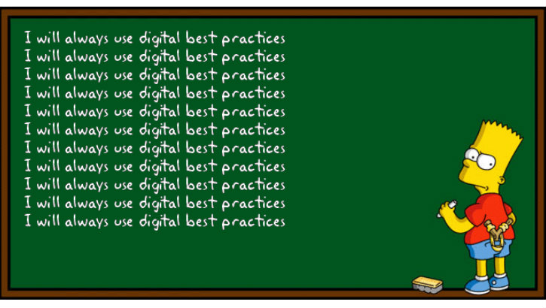
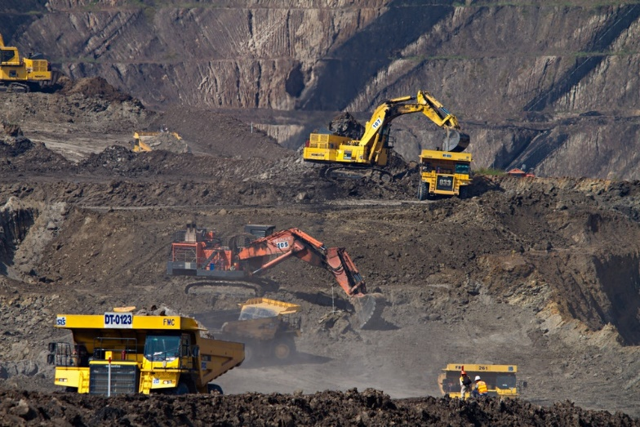

Revit API Event Examples:
Promote Best Practices
Data Mining
Batch Processing

Slide 11
Downloading the Code Examples
https://github.com/DanielTartaglia/Revit-API-Events-the-Forgotten-Power

Slide 12
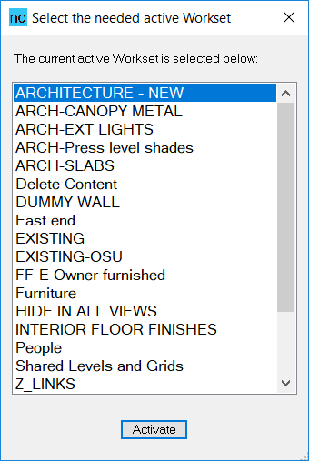
Promotes Best Practices:
‘Best Practices Example 01’ Tool
Reminds the user to specify a Workset when a model is opened
Uses the Revit API Event:
DocumentOpened()
Value:
Remind users to active the correct Workset
Prevent extra work of re-assigning objects
Cleaner models

Slide 13
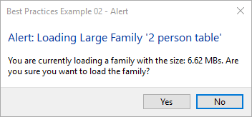
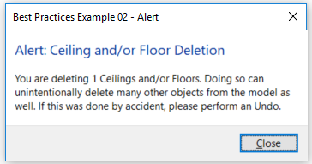
Promotes Best Practices:
‘Best Practices Example 02’ Tool
Value:
Assist users to load the desired families
Prevent possible model corruption
Promotes cleaner/smaller models
Prevent possible user error
When a family is loaded in the model:
Warns the user if the family is larger than 3 MBs, gives the chance to cancel
Uses the Revit API Event:
FamilyLoadingIntoDocument()
DocumentChangedEvent()
Warns the user if a ceiling or floor is deleted
Uses the Revit API Interface:
DocumentChangedEvent()
IUpdater Interface

Slide 14


Data Mining:
‘Extracting Data from Revit’ Tool
Value:
Track and correct model performance
Make sure user have the needed resources
Communicate information using Power BI
Automatically extracts data from every Revit user
Uses the Revit API Events:
DocumentOpening()
DocumentOpened()
DocumentSaving()
DocumentSaved()
DocumentSavingAs()
DocumentSavedAs()
DocumentSynchronizingWithCentral()
DocumentSynchronizedWithCentral()
DocumentClosing()
DocumentChanged()
ItemExecuted()
Windows Timer.Elapsed Event()

Slide 15
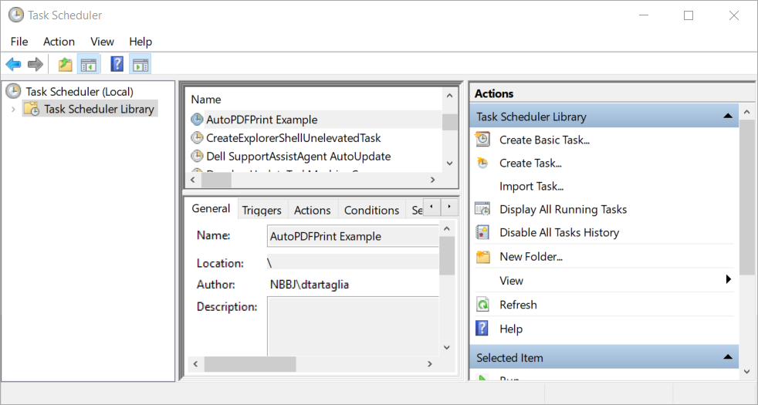
Batch Processing:
‘Automatic Printing to PDF’ Example
Using the Windows Task Scheduler and Revit to schedule printing to PDF
Uses the Revit API Events:
Idling()
DialogBoxShowing()
Value:
Automate tasks without user time
Expand this ability to perform other tasks

Slide 16




Batch Processing:
‘Automatic Printing to PDF’ Example
Windows Task Scheduler
AutoPDFPrint_Bridge.exe
AutoPDFPrint.dll
Copies config file to
temp folder, launches Revit
Get config file info, delete the file, use the Idling() event to open model and print to PDF
Close Revit
Specify the config file containing:
Sheet Set Name
Print Set Name
Model Full Path
Output folder for PDFs

Slide 17
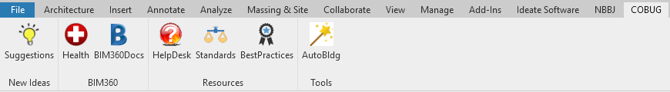
Bonus Example (if time permits)!
‘Ribbon Tab Example’ Tool
Uses the Revit API Event:
OnStartup()
Value:
Firm resources easily available
Place to create custom tools

Slide 18



Questions?
All examples will be available on GitHub
Dan Tartaglia
DTartaglia@nbbj.com
www.linkedin.com/in/dantartaglia/
@DanTartaglia66

Slide 19

Questions?
DTartaglia@nbbj.com
www.linkedin.com/in/dantartaglia/
@DanTartaglia66
Thank You!
09-10-2019
Dan Tartaglia / Revit API Events, the Forgotten Power

